Slide 1
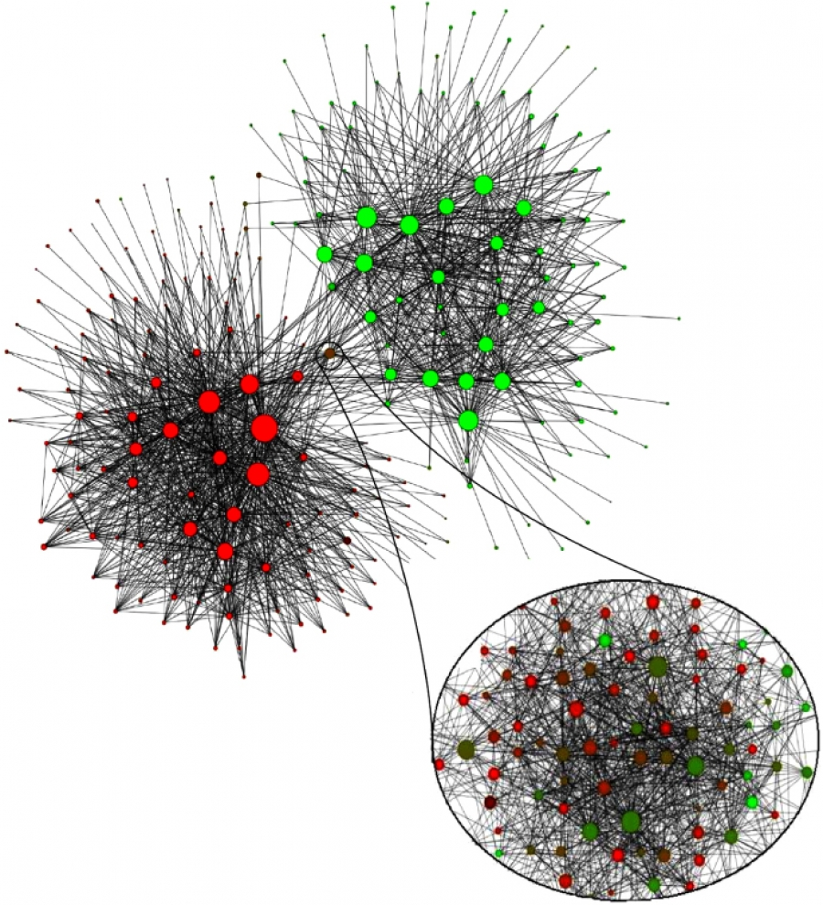

Network Science
CS 499/CS 599
Spring 2020
Morgan Vigil-Hayes

Slide 2
Case Study: Belgium
H1: A network’s community structure is uniquely encoded in its wiring diagram.
Notes:
Last video, we introduced the network science term of ”community”. In this video, we will be unpacking what community means in the context of network science.
[CLICK]
And you may not have realized it, but we actually started probing at a fundamental hypothesis surrounding community detection in networks, chiefly:
there is a ground truth about a network’s community organization, that can be uncovered by inspecting its adjacency matrix

Slide 3
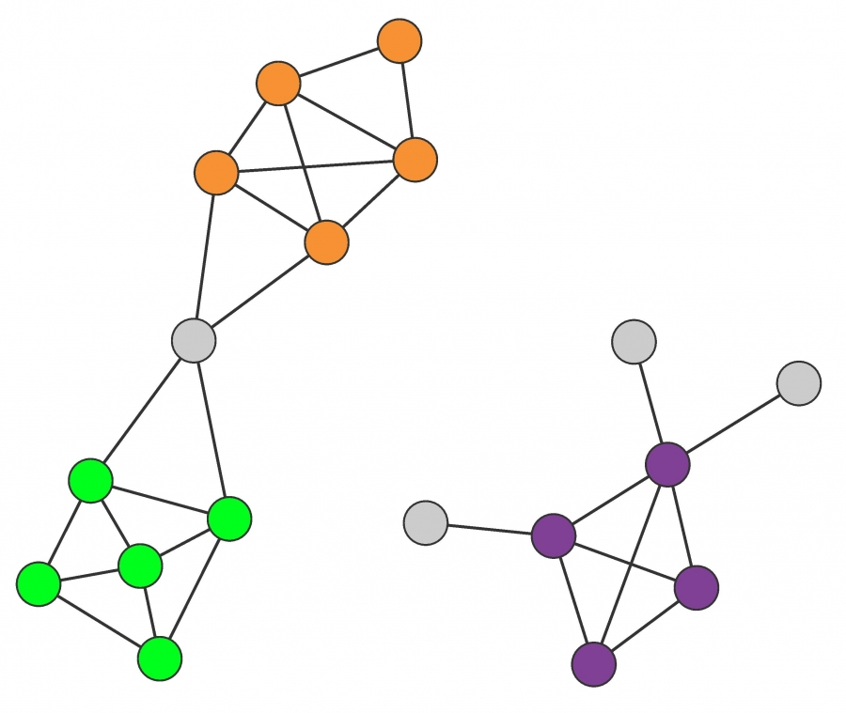
H2: A community is a locally dense connected subgraph of a network.
Notes:
But in order to identify a community, we need to start drilling down into the technical details of what a community is in a network. This can be clarified with fundamental hypothesis 2,
[CLICK]
Communities are locally dense connected subgraphs in a network. This expectation relies on two distinct hypotheses:
Connectedness Hypothesis Each community corresponds to a connected subgraph, like the subgraphs formed by the orange, green or the purple nodes. Consequently, if a network consists of two isolated components, each community is limited to only one component. The hypothesis also implies that on the same component a community cannot consist of two subgraphs that do not have a link to each other. Consequently, the orange and the green nodes form separate communities.
Density Hypothesis Nodes in a community are more likely to connect to other members of the same community than to nodes in other communities. The orange, the green and the purple nodes satisfy this expectation.

Slide 4
clique
Notes:
So let’s get into some more terminology.
When we are talking about a connected subgraph, we are actually referring to a clique.
The green, orange, and purple subgraphs are all cliques.
Are you wondering why the nodes circled in red are not a clique?
[CLICK]
Because usually when we use cliques, we talk about maximum cliques, which refer to the single largest possible connected subgraph that can be formed with some subset of nodes. Since the two nodes in green could be part of a larger clique than the one proposed by the red circle, they are not part of of this clique.
As you can imagine, it takes quite a bit to form a maximum clique and the most common clique that is found in a network is a triangle.

Slide 5
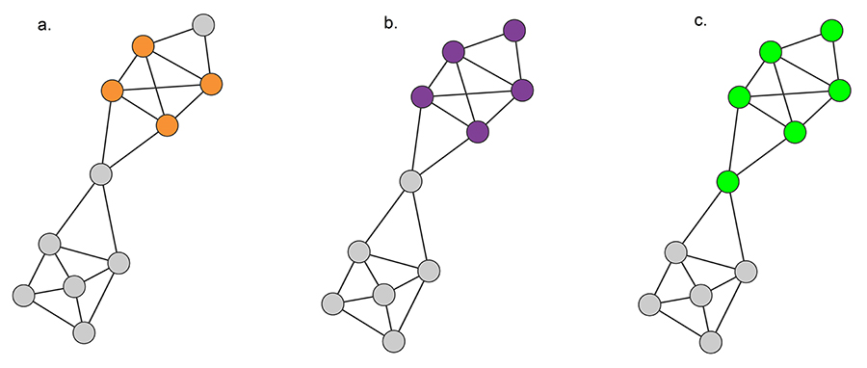


B
A
C
D
clique
$k_{i}^{int}$ is the number of degrees a node has inside the subgraph
$k_{i}^{ext}$ is the number of degrees a node has outside the subgraph
Notes:
One way we can relax this is by introducing two mechanisms that allow us to examine how well a node might fit inside a community. These mechanisms are k-int and k-ext. When we examine a subgraph as a potential community, we can examine its k-int and k-ext values and compare them. If a node’s k-int value for a particular subgraph is 0, it probably does not fit into that community. If it’s k-ext value is 0, it is probably a very good fit in that community.
WALK THROUGH EXAMPLE WITH A

Slide 6


B
A
C
D
clique
strong community
For all $i∈C,$
$$k_{i}^{int}\left(C\right)>k_{i}^{ext}(C)$$
Notes:
One alternative definition for a community is a strong community.
A strong community is a subgraph where for all nodes in the subgraph, k-int is greater than k-ext
As you can see with graph b, this slight relaxation allows us to add another node to our community definition.

Slide 7
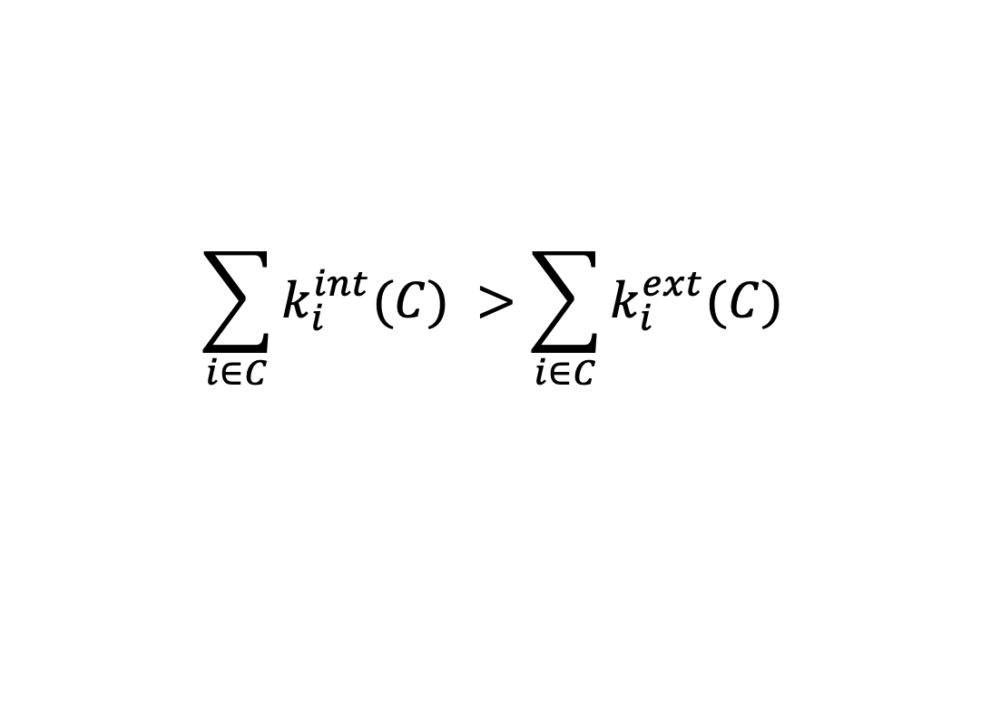
B
A
C
D
clique
strong community
weak community
$$\sum_{i∈C}{k_{i}^{int}(C)} >\sum_{i∈C}{k_{i}^{ext}(C)}$$
Notes:
To further relax this condition, we can define communities as being weak communities, where only the sum of all nodes’ k-int values need to be larger than the sum of all nodes k-ext values. We can see this in graph C, where an extra node joins our definition of a community.
As we introduce this new concept of community, you might wonder how we might find all possible communities in a graph. A good thought exercise would be to consider how you might go about finding all possible communities and then how computationally expensive the approach might be.
We will continue the topic of graph partitioning into multiple communities in the next video.

